Slide 1
Barriers and Successful Strategies for Engaging Rural Populations in State Comprehensive Cancer Control Planning: Program Manager Perspectives
Whitney Zahnd, PhD
University of Iowa
September 25, 2023
geohealthequity.org
Acre-lab.org
cpcrn.org

Slide 2
Webinar Housekeeping: Zoom Webinar Orientation
You are muted by default. The host can un-mute participants, if needed
Send a general message/comment
Do not use
Ask a question

Slide 3
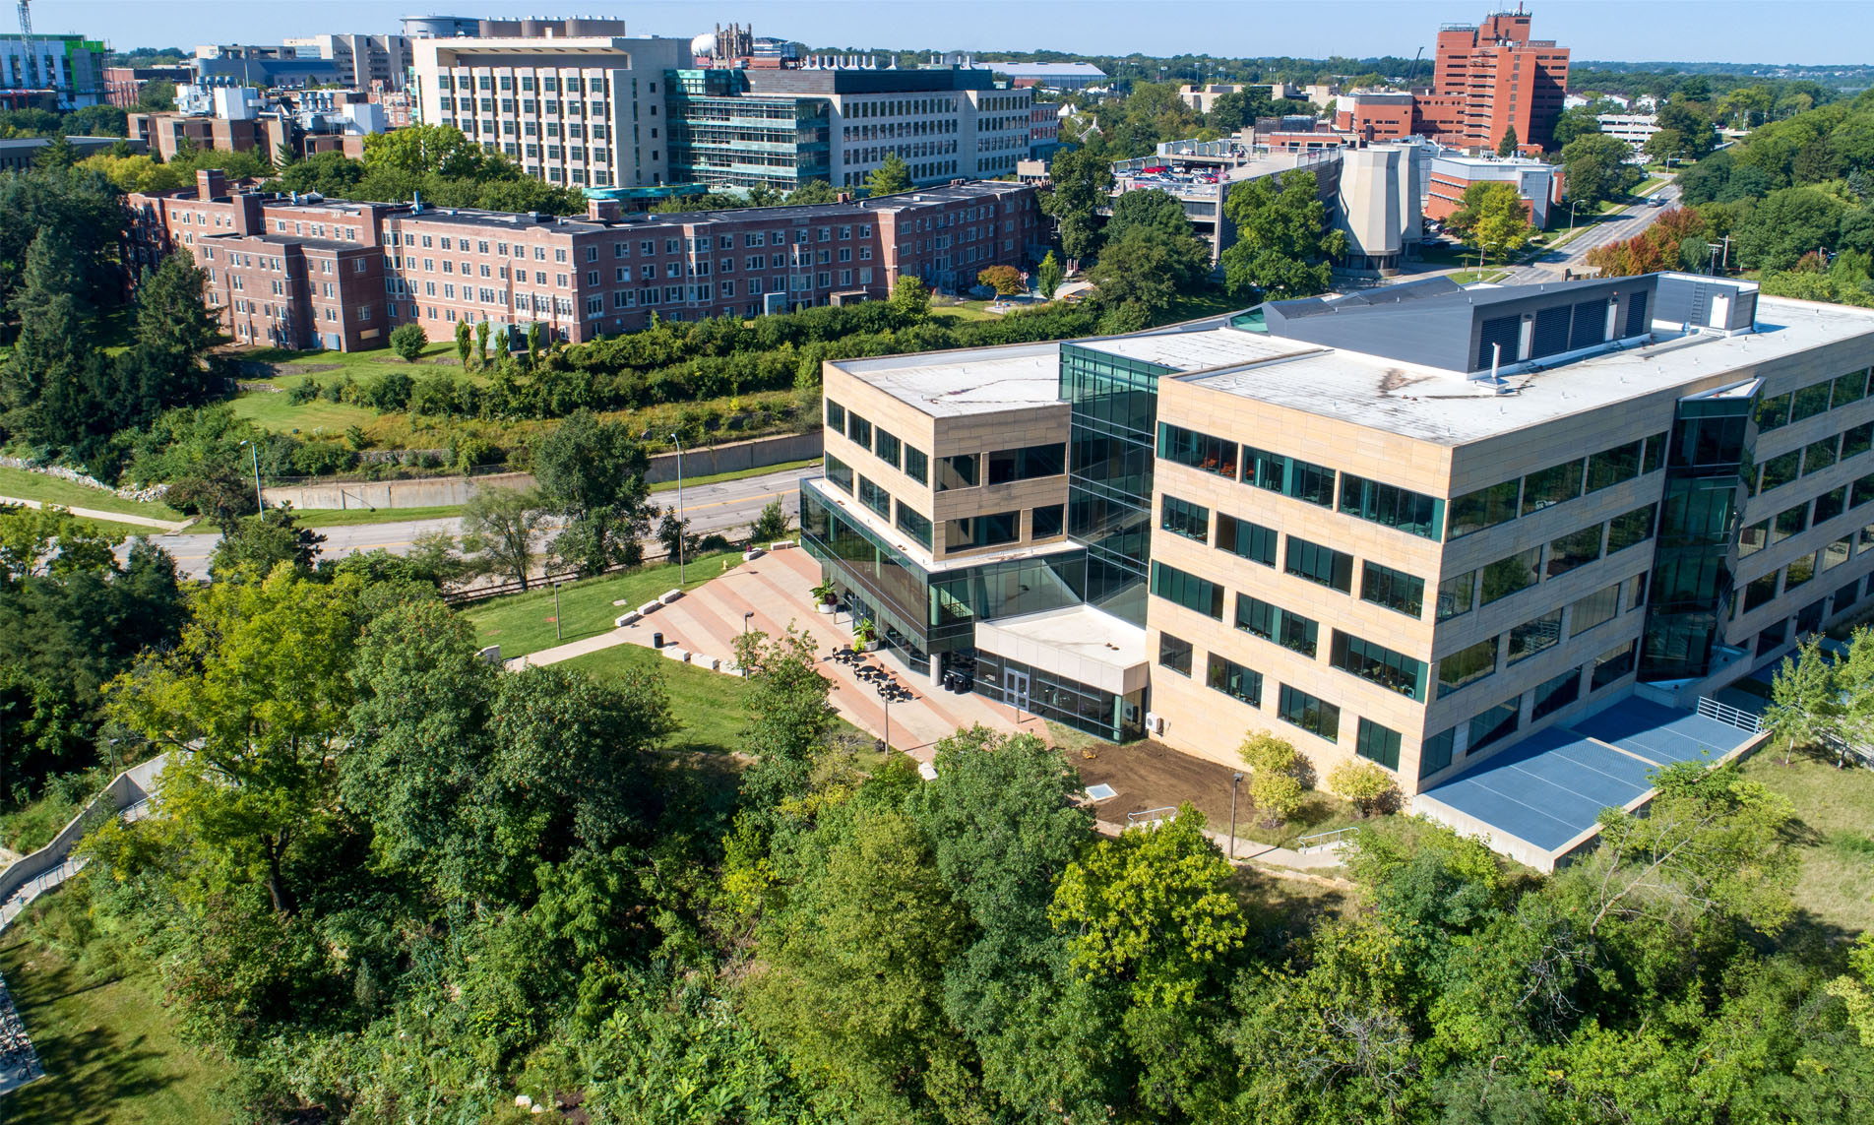
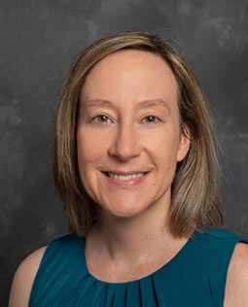
Meet the Presenter
Whitney Zahnd, Ph.D.
Assistant Professor
Department of Health Management and Policy
University of Iowa

Slide 4
Cancer Prevention and Control Research Network (CPCRN)
Vision: Reduce the burden of cancer in U.S. populations and eliminate cancer disparities
Mission:
Accelerate the adoption and implementation of evidence-based cancer prevention and control strategies in communities
Enhance large-scale efforts to reach underserved populations and reduce their burden of cancer
Deepen our understanding of the predictable processes that achieve those goals
Develop the Dissemination and &Implementation workforce in cancer prevention and control
Workgroups and interest groups focused on a variety of areas, including rural cancer

Slide 5
Objectives
To describe how rural perspectives are included in comprehensive cancer control planning processes.
To identify barriers and strategies to including rural perspectives in comprehensive cancer control planning processes.

Slide 6
Rural Cancer Disparities
Sociodemographic Characteristics
15-20% of Americans live in rural areas
24% of rural persons are people of color
Older and poorer than urban populations
Cancer Outcome Disparities
More prevalent “risky” health behaviors, overall and among survivors
Higher incidence rates of preventable cancers
Lower screening rates
Higher mortality rates
Cancer Care Disparities
Less access to primary care practitioners, cancer specialists, NCI-designated cancer centers
Less likely to receive guideline-concordant treatment
Sources: U.S. Census Bureau. Rural Health Information Hub. Matthews et al. MMWR Surveill Summ 2017. Henley et al. MMWR Surveill Summ. 2017. Zahnd et al. Cancer Epidemiol Biomarkers Prev. 2018. Cole et al. Cancer Med. 2012. Onega et al. Cancer. 2017. Hung et al. Cancer. 2019. Chow et al, Dis Colon Rectum. 2015.; Charlton et al, Oncology, 2015.

Slide 7
Rural Cancer Incidence Disparities
Rural populations had higher incidence of tobacco-associated, HPV-associated, and
colorectal cancer.
Source: Zahnd et al. CEBP. 2018.

Slide 8
The Need for Rural Inclusion in Comprehensive Cancer Control Planning
“The Committee recommends the CDC require states, territories, and tribes or tribal organizations to assess rural-urban cancer mortality rates as part of their cancer control plans and, where appropriate, develop and implement rural-focused cancer control goals, objectives, or strategies, participation in areas with high rural cancer mortality rates.”
National Advisory Committee on Rural Health and Human Services Report, August 2019

Slide 9
How have rural-relevant goals, objectives, and strategies been included in past plans?
A content analysis of all plans on the CDC’s website as of January 2020 was performed.
38/50 states had some rural element included
29/50 had include a rural description of cancer disparities
17/50 had data on cancer burden
2/50 had a rural-specific goal
4/50 had a rural-specific objective
18/50 had a rural-specific strategy
Source: Murphy et al, 2021, Preventing Chronic Disease

Slide 10
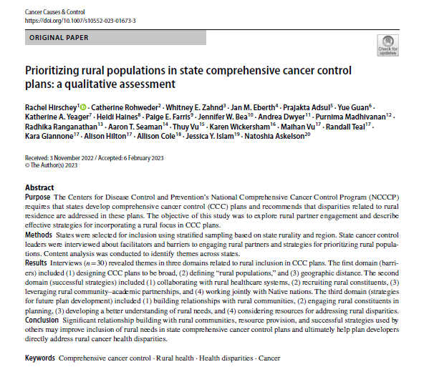
Inviting the question…
How have state comprehensive cancer control programs engaged rural partners and included rural perspectives in planning processes?

Slide 11
Methods-Sampling and Recruitment
Cancer Prevention and Control Research Network (CPCRN) Rural Cancer Workgroup conducted 30 interviews with state cancer control leaders to assess how they engaged rural partners and addressed rural priorities in their plans (May to August 2021)
States were identified for inclusion in the study using a stratified random sample, stratifying by rurality and region
“High” (>20.5% of the population living in rural counties) vs. “low” (<20.5% of the population living in rural counties)
U.S. Census Region (Northeast, Midwest, South, and West)
Ultimately 39 states were contacted with 30 agreeing to participate

Slide 12
Methods-Interviews and Analysis
CPCRN cancer workgroup members interviewed cancer control leaders following a semi-structured interview guide focused on the “rural” inclusion of rural in comprehensive cancer plan:
Development
Content
Implementation
Evaluation
Future Plans
Interviews were audio recorded, transcribed, and analyzed to identify themes, subthemes and illustrative quotes

Slide 13
Results-state and interview participant characteristics
18 (60%) interviewees were from “high” rural states
Proportionately representative across regions (57% from the South or Midwest)
Most (83%) were affiliated with the comprehensive cancer control program
Plurality (35%) had 3-5 years of experience in their current role

Slide 14
Results-Identified Domains of Themes
Barriers to prioritizing rural populations in comprehensive cancer control planning (CCCP) processes
Successful strategies used to include a rural focus in CCCPs
Strategies suggested or planned by interviewees in future CCCPs

Slide 15
Results-Barriers to Rural Inclusion
Beliefs that CCCPs should be broad and general
[The plan] doesn’t set any specific priorities for addressing specific disparities; it’s just kind of a general overview of disparities in cancer care.”
Challenge of defining “rural populations”
“I was looking at the numbers… If you look at like HRSA…five counties are actually considered rural…[but] if I go by the state definition of rural with our collaborative members…about 31% [of our counties are rural].”
Geographic distance
“For some it even required an overnight stay and depending on what their role with their employer was, it might not have been an activity that the employer would support their participation without them using their own time to do so.”

Slide 16
Results-Implementation
Varying levels of rural involvement were identified
Methods of involvement
Workgroup/coalition involvement
“So, we have health departments that are serving more of our rural populations that are actively engaged as leadership members and just in our coalition. We have probably nonprofit organizations and those that are doing that work within communities. So, we have nonprofit organizations that are working in our local communities in the northern part, which is more of our rural areas that are actively involved in the coalition.”
Specific health Issues
“So, the western part of the state with survivorship, it was a survivorship workgroup that was sort of revitalized during this time period, and it had been very, very active. They created a beautiful document for survivors around the six dimensions of wellness, and did that, and then it had to be rejuvenated after that. In that rejuvenation, it was a lot of relationship building to be able to go out and recruit people from different areas of the state and luckily, we were able to get people to be engaged.”

Slide 17
Results-Barriers to Rural Involvement in Implementation
Lack of resources
Rural stakeholders already have too many responsibilities
Lack of collaboration efforts
Political factors

Slide 18
Results-Barriers to Rural Involvement in Implementation
Lack of resources
“So beyond just what you said, of course, I think a major barrier is the limitations in financial resources in rural communities, finances, finances, finances. Unless you are in an area where a large university is that maybe has a little bit more of those resources, especially for healthcare…”
Lack of collaboration efforts
“I think at the time our executive director was kinda newer at it. So, he jumped in knowing that I've got a cancer plan I got develop. Now, it wasn't attempted to reach out to, uh, a few. I know of at least one, um, rural provider, not provider stakeholders that has...statewide access to all the rural, um, provider, PCP offices. But at the time there was not a lot of, of attraction out of that we could get...much feedback from the group. Since then, you know, that relationship has grown. And I think there'll be a much more, um, there'll be a greater collaboration on the development of it, upcoming cancer plan.”

Slide 19
Results-Rural Involvement in Plan Evaluation
Recruitment and inclusion of rural representatives on the evaluation committee
Evaluation focus group designated for rural participants
Tribal partner involved with the evaluation
Rural stakeholders with implementation grants have their own evaluation process
Cancer plan stakeholders were in and/or serve rural areas
The contracted evaluator came from a rural part of the state
State was mostly rural, so rural involvement was implicit
Data from rural areas was included in summaries and analyses

Slide 20
Results-Barriers to Rural Involvement in Evaluation
No outside involvement in the evaluation process, so no rural stakeholders involved
“And then how our rural stakeholders are involved in evaluation, if at all. Evaluation of the plan is done within the health department so outside stakeholders are not typically involved in the process. However, our tracking indicator data is annually published to the plan dashboard. So, rural stakeholders are able to monitor progress themselves.”
Geographic distance
Lack of relationship with rural stakeholders
Evaluation metrics may not be relevant to rural areas that experience immediate needs
COVID-19 hit rural areas especially hard and made it difficult for rural partners to get involved

Slide 21
Results-Suggested or Planned Strategies
Building relationships with rural communities
“We can’t develop another cancer plan that hasn’t been vetted by not just, you know, academics and stakeholders, but by gatekeepers in the communities that we’re trying to affect.”
Actively engaging rural partners in plan development
soliciting “applications for new board members…we want someone from up north, from the east and we want it to be rural…We want diversity, geographic diversity in our new board members.”
Developing a better understanding of the rural needs in their state
“trusting communities to know what they need for themselves… we should be thinking about it as, what are we missing in terms of not being able to serve them in the way that they’ve needed to be served?”
Considering resources needed by rural populations
they have created “an extensive list of … transportation resources that are…ADA accessible.”

Slide 22
Results-Strategies for Rural Inclusion
Collaborating with healthcare systems in rural areas
“membership from some smaller cancer centers that are in more rural areas or serve rural communities” in state cancer consortia
Actively recruiting rural constituents
“We did get the rural voice in these seven different work groups. We made sure it wasn’t metro voice only.”
Leveraging rural community–academic partnerships
“rural cancer advisory group that meets regularly, so we kind of pull from their talent and input.”
Seeking native nation involvement
“We’ve always worked with them directly on the development of [our] plan, the activities related to their needs, and what they’re looking to accomplish.”

Slide 24
Key Takeaways
Focus on relationship building with rural communities
Work through established community partnerships
Identify and seek engagement from rural areas that have not previously been represented in the planning process
Develop deeper understanding about state-specific gaps, assets, and resources
Focus on identifying and building resources needed to meet rural health needs

Slide 25
Acknowledgments
CPCRN co-authors: Rachel Hirschey, Catherine Rohweder, Jan Eberth, Prajakta Adsul, Yue Guan, Katherine Yeager, Heidi Haines, Paige Farris, Jennifer Bea, Andrea Dwyer, Purnima Madhavinan, Radhika Ranganathan, Aaron Seaman, Thuy Vu, Karen Wickersham, Allison Cole, Jessica Islam, Natoshia Askelson
CHAI Core Team: Maihan Vu, Randall Teal, Kara Giannone, Alison Hilton

Slide 26
For more information…
Rural Inclusion in Comprehensive Cancer Control Planning Webinar Series
Defining and Describing Rural Communities in Comprehensive Cancer Control Planning
Building Rural-Focused Partnerships in Comprehensive Cancer Control Planning
Setting Rural-Focused Goals and Strategies in Comprehensive Cancer Control Planning
Identifying and Implementing Evidence-Based Strategies in Comprehensive Cancer Control Planning
Link to journal article

Slide 27
Thank you!
Whitney Zahnd, PhD
Assistant Professor
Health Management and Policy
whitney-zahnd@uiowa.edu
https://www.public-health.uiowa.edu/hmp/
www.cpcrn.org

