Slide 1
Advocating for Policy Change to Support HPV Vaccination
Whitney Zahnd, PhD
February 22, 2024

Slide 2
Objectives
To identify partners and policy levers for HPV vaccination.
To use data to advocate for policy change to support HPV vaccination.

Slide 3



Where We Are
HPV Cancers Are on the Rise
More Research Affirms the Effectiveness of HPV Vaccines
Unique Policy Challenges in a Peri/Post Pandemic Environment

Slide 4
Policy Levers
Little “p”
  Organizational changes, guidelines, internal agency decisions or memoranda
  Enacted by departments or agencies
Big “P”
  Formal laws, administrative rules and regulations, taxes, public budgets
  Enacted by elected officials

Slide 5
Our Current Challenge
Misinformation about vaccines broadly
Increasing efforts to rollback current laws, regulations, rules, etc. (e.g., Iowa)
  In 2023, a law was passed removing requirement of teaching about the availability of the HPV vaccine
  Current legislative session-bills under consideration that would disallow minors from receiving care (including preventive vaccines, like the HPV vaccine) for a sexually transmitted disease/infection without parental consent
We’re in a place where preventing policies that negatively impact HPV vaccination is just as important as promoting bills with an anticipated positive impact

Slide 6
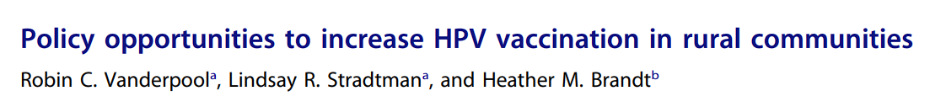
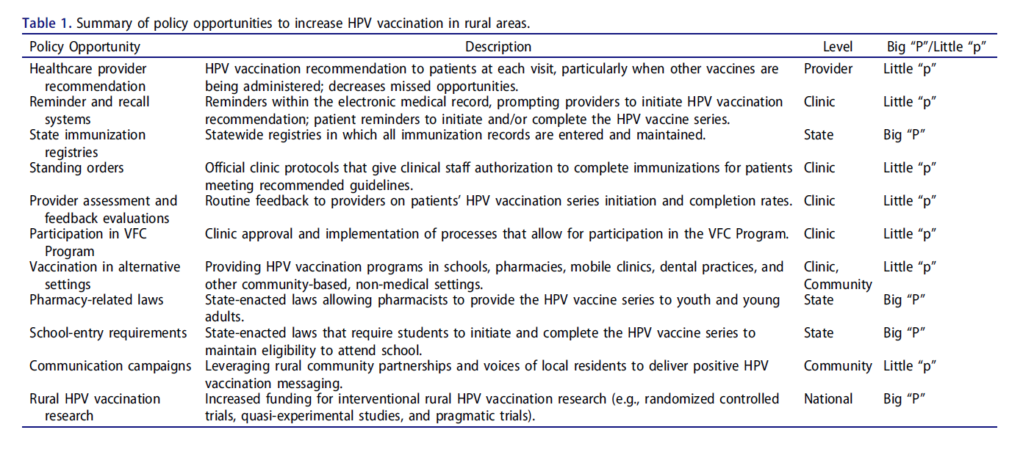
Notes:
We had a few sources of inspiration for some of the work we have been doing and thinking about supporting Big and Little P Policy Change, and of the sources of inspiration was this publication by Dr.s Vanderpool, Stradman, and Brandt, which developed a lovely table in this research article, highlighting big and little P policy opportunities to increase HPV vaccination in rural communities.
So you can see here, they sorted these different policy options, all of which are supported by evidence, into the Big and Little P buckets.

Slide 7
Examples of policy recommendations
Recommendation 1: Leverage meningococcal conjugate vaccination as a model for HPV vaccination education and recommendations
Recommendation 2: Expand health care provider and practice staff education and training related to HPV vaccination and strengthen HPV vaccination recommendations for parents and caregivers
Recommendation 3: Improve efforts to recruit and enroll various types of health care providers in the federal Vaccines for Children (VFC) program
Source: St. Jude’s HPV Cancer Prevention Program

Slide 8
Examples of policy recommendations
Recommendation 4: Expand the resources available to improve HPV vaccination data collection and reporting through state immunization information systems (IISs)
Recommendation 5: Engage in efforts to preserve and expand eligibility for Medicaid
Source: St. Jude’s HPV Cancer Prevention Program

Slide 9

5000 Foot Level-What’s the Problem?

Slide 10
HPV Vaccination Relevant Policies
Immunize.org
  States with or without school-related mandates for HPV vaccinations
Kaiser Family Foundation
  State-specific Medicaid Coverage for Vaccines among those aged 21 and older
Keep an eye on NCSL, KFF, NASHP, Temple Law Atlas

Slide 11
HPV-associated Cancer Incidence
Cancer Registry Data
  Ways to Get Data:
    Work with your state’s central cancer registry
    Get access to the CDC’s Public Use Data Set
  Relevant data
    Individual HPV-associated cancers
    Overall HPV-associated cancers

Slide 12
HPV-Associated Cancers, 2015-2019
Preliminary Analysis of U.S. Cancer Statistics Public Use Database Data

Slide 13
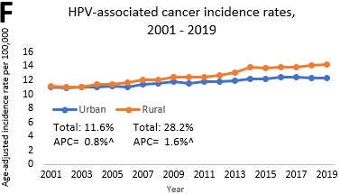
HPV-Associated Cancer Trends, 2000-2019
Source: Semprini et al, Under Review

Slide 14
Trends in HPV-Associated Oropharyngeal Cancer Rates, 2000-2019
Non-Metro % Change:+70.8%
Metro % Change:+39.4%
Preliminary Analysis of U.S. Cancer Statistics Public Use Database Data

Slide 15
Trends in HPV-Associated Cervical Cancer Rates, 2000-2019
Non-Metro % Change:-10.8%
Metro % Change:-18.5%
APC=annual percent change
Preliminary Analysis of U.S. Cancer Statistics Public Use Database Data

Slide 16
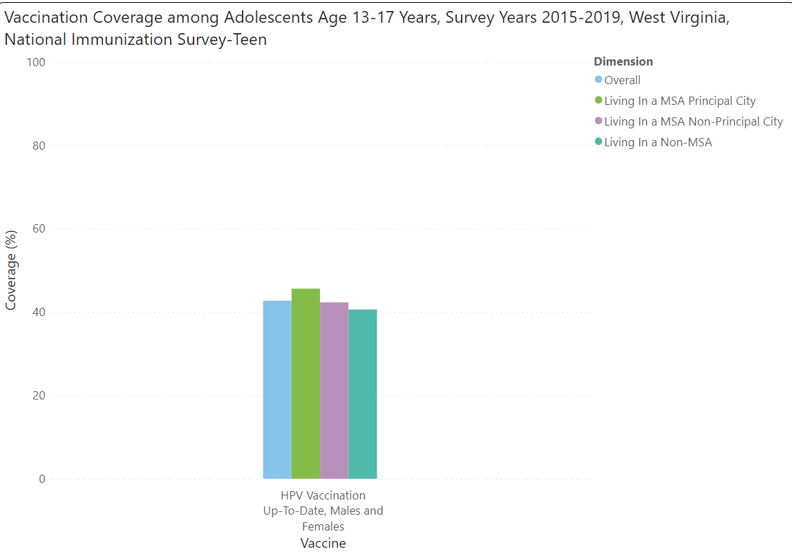
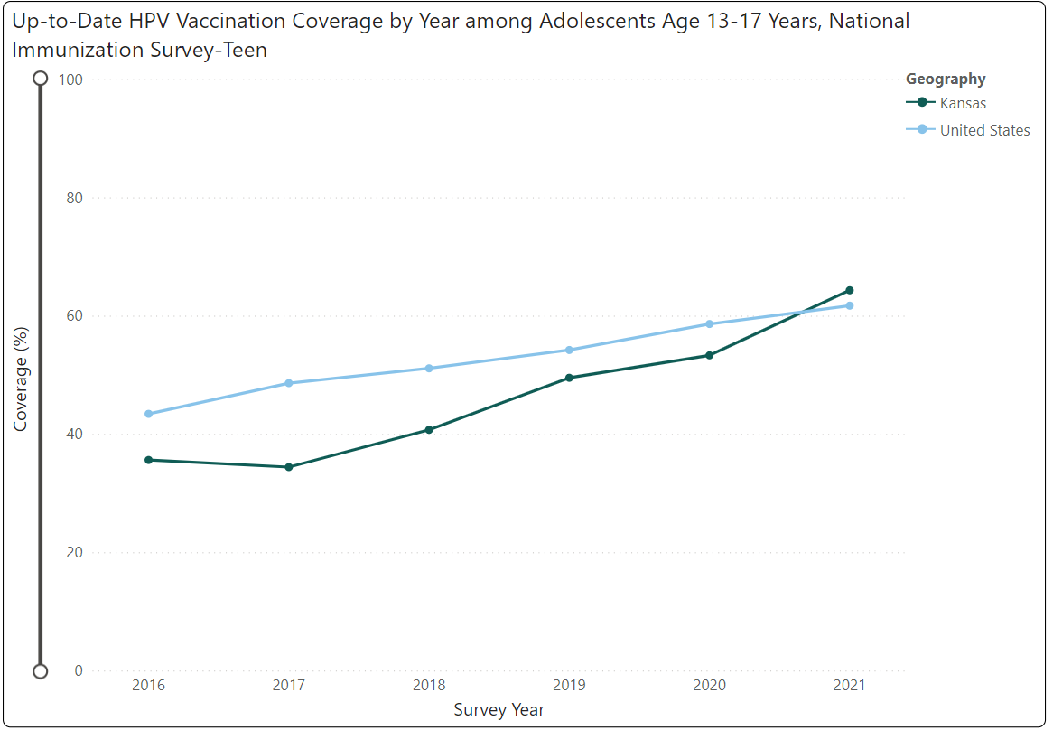
HPV Vaccine Coverage
Potential Data Sources:
  % of adolescents who have received 1,2,3 doses or who are up-to-date on HPV Vaccination-CDC’s Teen Vax View
  % of adults who have had an HPV vaccination-optional Behavioral Risk Factor Surveillance System (BRFSS) module

Slide 17
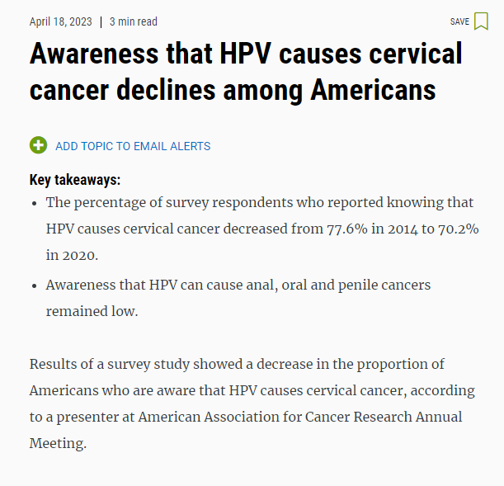
HPV Knowledge and Recommendations
Health Information National Trends Survey Data
  Knowledge and Risk of HPV
    Has heard of HPV
    Knows that HPV can be spread through sexual contact
  Knowledge and Perception of HPV Vaccination
  Doctor Recommended HPV Vaccination
Note: State-level estimates are not available, but these data may provide an understanding of HPV-related knowledge

Slide 18

On the Ground (Opportunity)-Level

Slide 19
Local Qualitative and Quantitative Data
Groups to engage
Data Collection Approaches
Questions to Explore
Parents
Youth
Providers
Collaborative partners (e.g., schools, public health departments)
Key informant interviews
Listening sessions
Focus groups
Small-scale surveys
Knowledge
Awareness
Clinical practices
Educational practices

Slide 20
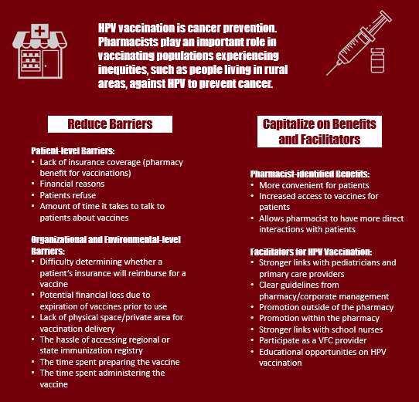
Example of Local Quantitative Data
Source: 2021 APHA poster presentation

Slide 21

Example of Using Data and Partnership to Promote Policy Change

Slide 22
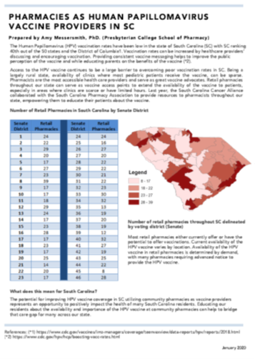
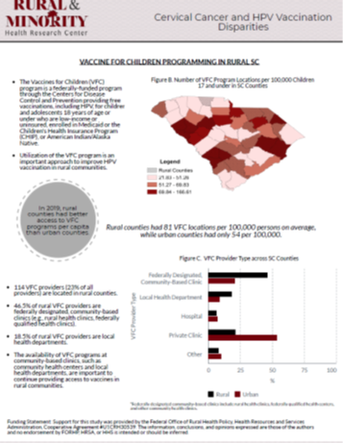
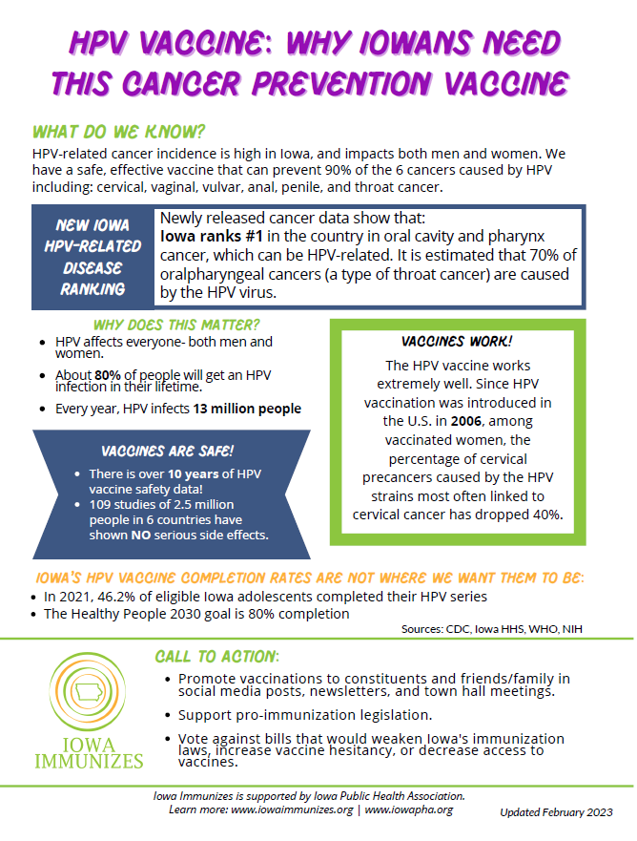
Data Visualization and Briefs for Policy Change

Slide 23
Partnerships
Leverage existing partnerships
  Relevant, even if slightly tangential
  Cross-sector
  Multilevel
Find intersections (e.g., cancer and immunization coalitions)
Connect with nationwide resources

Slide 24
Example: Partnering on Vaccine Initiatives
Keep Kids in School Coalition
Springfield Collaborative for Active Child Health
  Partners:
    SIU School of Medicine (Pediatrics, Family Medicine, Internal Medicine, Research)
    Springfield School District
    Springfield Urban League (Head Start)
    IDPH (Illinois)
    YMCA
  Goal: Address nutrition and physical activity in elementary schools and Head Start
  Funding from BlueCross BlueShield
Partners:
    SIU School of Medicine (Pediatrics, Family Medicine, Internal Medicine, Research)
    Springfield School District
    Sangamon County Health Department
  Goal: To address noncompliance with state-mandated physical and immunization requirements in schools.

Slide 25
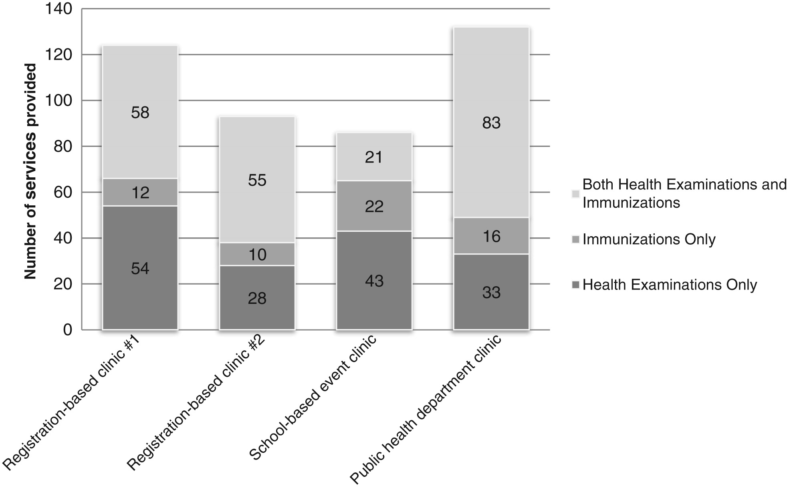
Partnering on Vaccination Initiatives-Keep Kids In School Coalition
Coalition accomplishments:
  Successfully advocated for earlier “medical exclusion” date
  Educated parents, teachers/staff on new policies
  Provided services to 414 students through targeted clinics
457 fewer students were “medically excluded” at the deadline in 2014-2015 compared to 2013-2014
  Students were up-to-date on needed preventive services and weren’t unnecessarily missing school
  The school district received funding otherwise lost due to student absenteeism
Source: Rogers et al, 2016; Journal of School Health

Slide 26
Key Takeaways
Consider the challenging policy environment
Use data and stories to advocate for change
Leverage established partnerships and develop new ones to advocate for change

Slide 27
Thank you!
Whitney Zahnd, PhD
Assistant Professor
Health Management and Policy
whitney-zahnd@uiowa.edu
https://www.public-health.uiowa.edu/hmp/
www.acre-lab.org

